Slide 1
Employee Salary Prediction using Gradient Boosting Classifier
CAPSTONE PROJECT
Presented By:
Name- SAKARAPALLI PAVANI
Collage Name- Vivekandha P.G collage(MCA)
Registration ID- STU6837fc16c39781748499478

Slide 2
OUTLINE
Problem Statement (Should not include solution)
System Development Approach (Technology Used)
Algorithm & Deployment (Step by Step Procedure)
Result
Conclusion
Future Scope(Optonal)
References

Slide 3
Problem Statement
The aim of this project is to predict whether an employee earns more than 50K annually using demographic and work-related features. This classification problem is based on the Adult dataset. The data includes attributes like age, education, occupation, and working hours. The challenge is to build a machine learning model that accurately classifies salary groups. By doing this, organizations can enhance HR analytics, automate salary group prediction, and support strategic hiring decisions.

Slide 4
System Approach
The "System Approach" section outlines the overall strategy and methodology for developing and implementing. Here's a suggested structure for this section:
System requirements - Python 3.x - Jupyter Notebook or Google Colab
Library required to build the model - pandas for data handling - NumPy for numerical operations - matplotlib and seaborn for visualization - scikit-learn for preprocessing and modeling

Slide 5
Algorithm & Deployment
Algorithm Used: GradientBoostingClassifier
Step-by-Step Procedure:
1. Load the dataset (adult.csv)
2. Clean and preprocess the data (remove '?' entries, drop irrelevant rows)
3. Encode categorical variables using OneHotEncoder
4. Scale numerical features using StandardScaler
5. Split data into training and testing sets (80-20 split)
6. Build a pipeline using ColumnTransformer and GradientBoostingClassifier
7. Train the model on the training data
8. Evaluate using accuracy and classification report
9. Save and optionally deploy the model

Slide 6
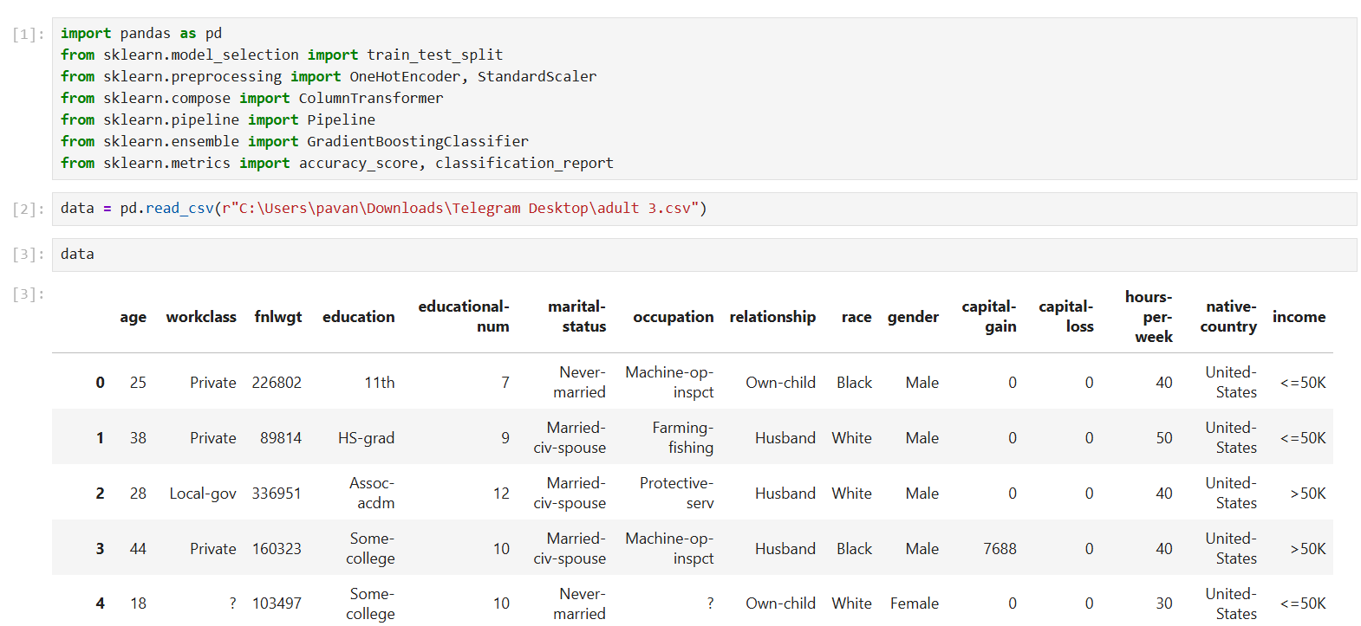
Result

Slide 7
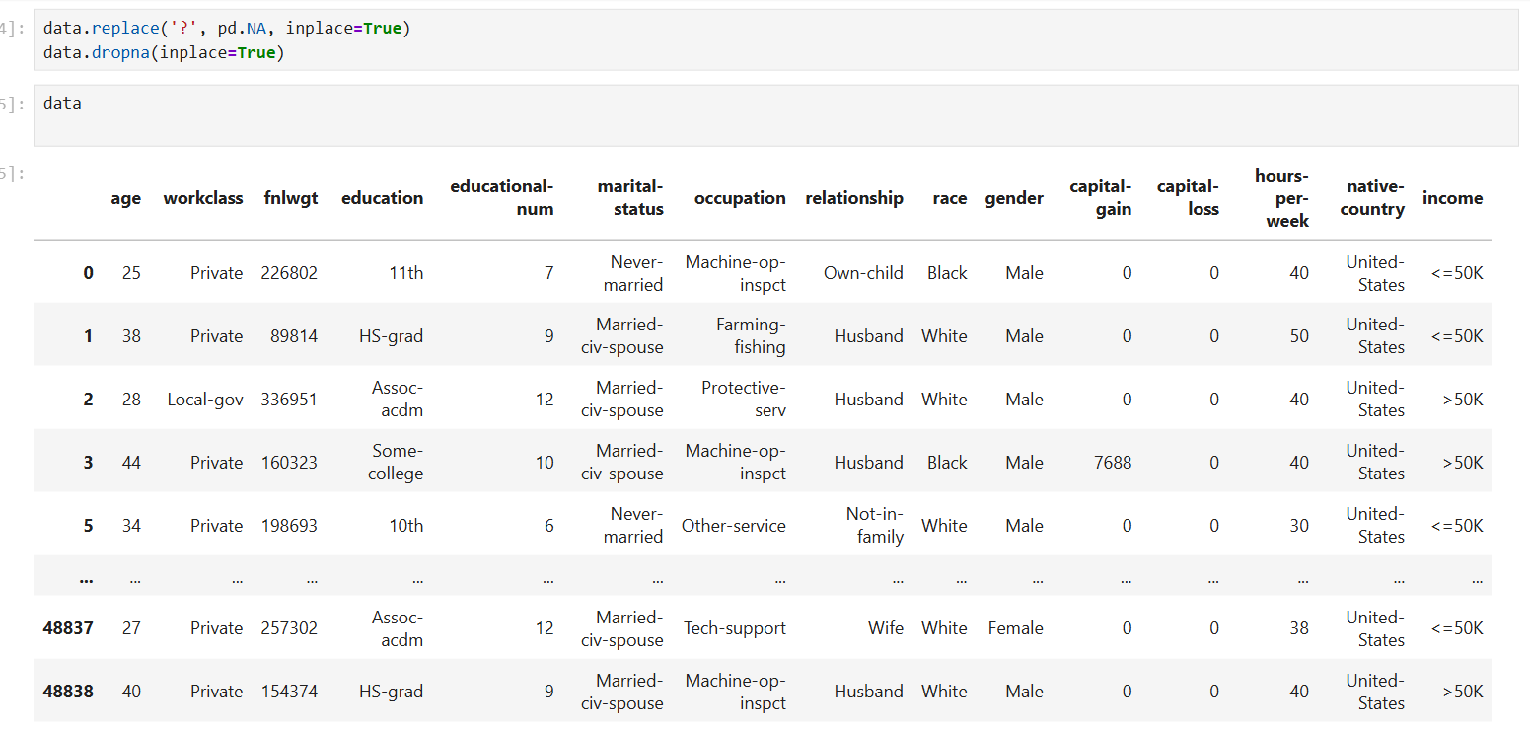

Slide 8
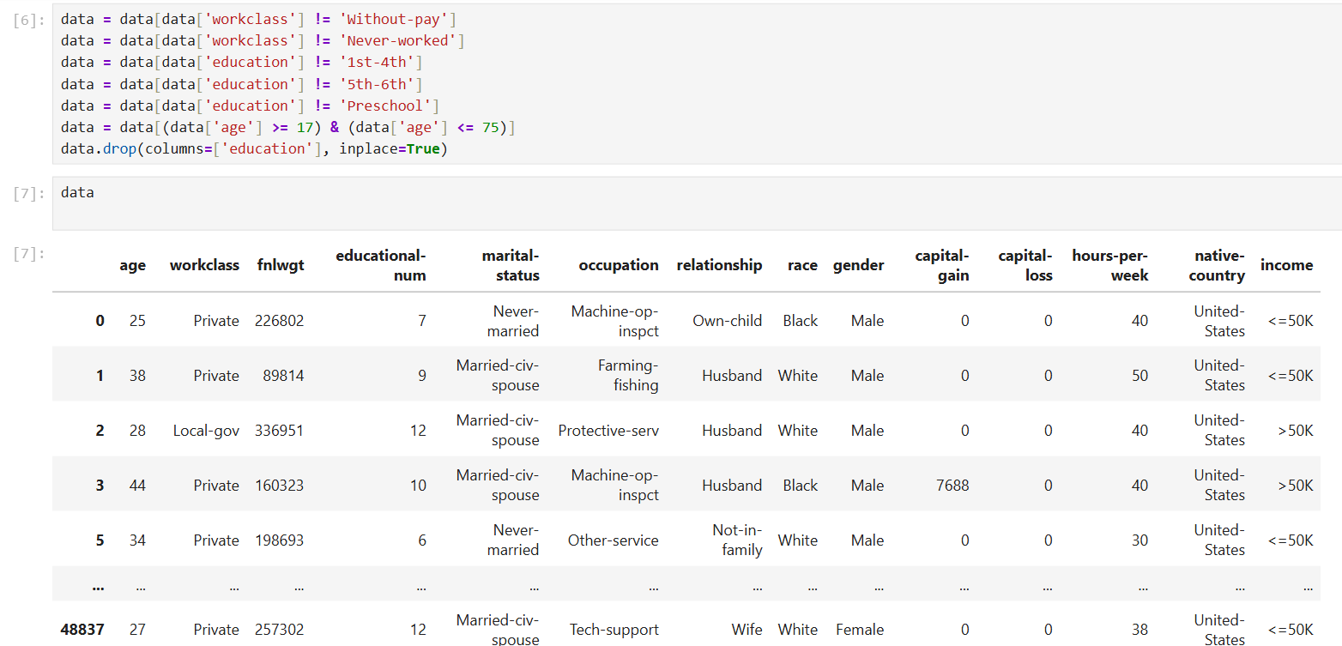

Slide 9
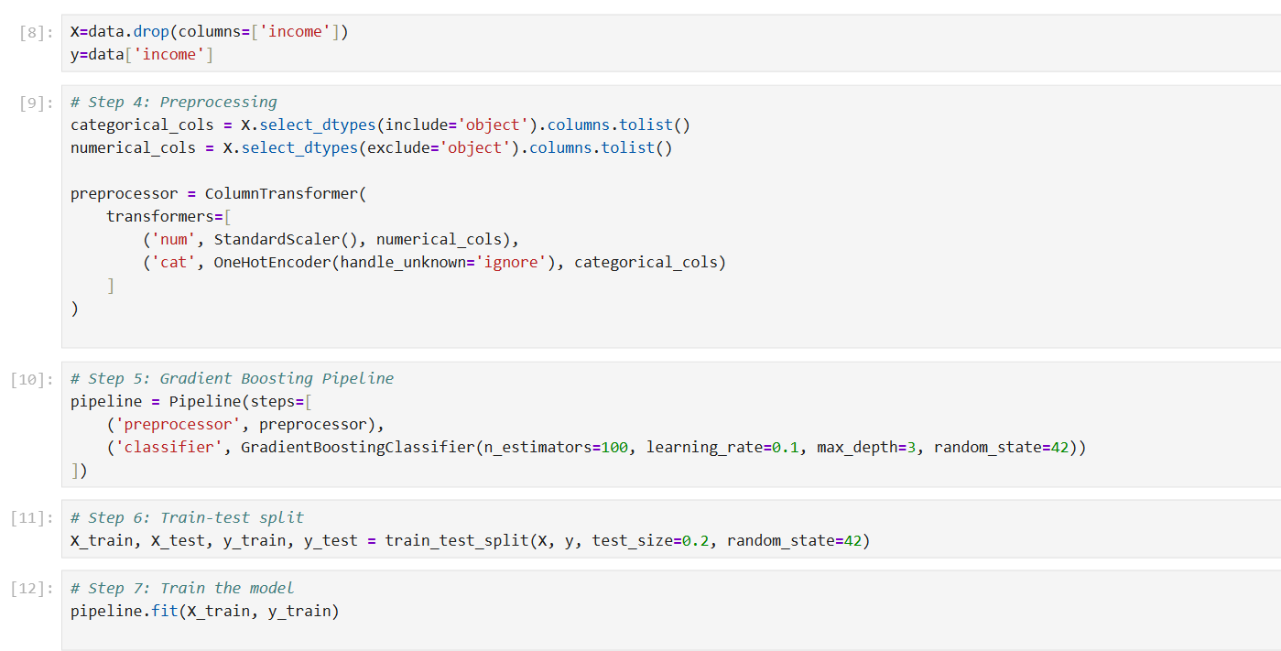

Slide 10
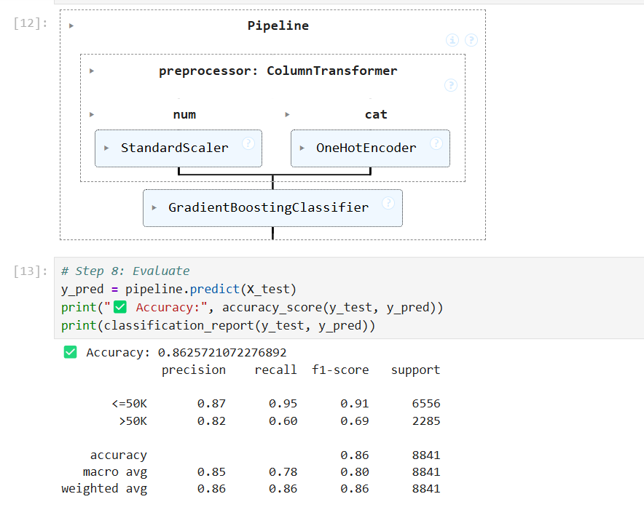

Slide 11
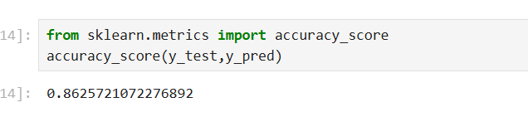
GitHub Link: https://github.com/SakarapalliPavani/employee-salary-prediction.git

Slide 12
Conclusion
The Gradient Boosting Classifier effectively predicted employee salary brackets with high accuracy. Data preprocessing played a vital role in improving model performance. Gradient Boosting outperformed simpler models like KNN in this case. Challenges included handling missing values and optimizing hyperparameters. Future improvements could involve hyperparameter tuning and model deployment as a web app.

Slide 13
Future scope(Optional)
Try advanced gradient boosting libraries like XGBoost or CatBoost
Integrate with a web app using Flask or Streamlit
Enable real-time salary prediction for HR tools

Slide 14
References
UCI Machine Learning Repository: Adult Dataset
Scikit-learn documentation: https://scikit-learn.org
Towards Data Science articles on Gradient Boosting
GitHub examples of salary prediction models.

Slide 15
THANK YOU

